Slide 1



Shannon–Fano coding Using Python
( Digital Communication Project )
Group Members:
Anshumat Dinesh (BT21ECE023)
Hritik Kumar Gupta (BT21ECE049)
Nisarg Jain (BT21ECE024)

Slide 2
ACKNOWLEDGMENT
We would like to express our deepest gratitude to professor dr. Rashmi Pandhare for entrusting us with the digital communication project “Shannon–fano Coding using Python”. And for her unwavering guidance and support throughout its development.
Professor Dr. Rashmi Pandhare's expertise and insightful feedback were invaluable in shaping the project and ensuring its successful completion. Her dedication to our learning and her commitment to excellence served as a constant source of motivation.
We would also like to extend our appreciation to Anshumat Dinesh, Hritik Kr. Gupta and Nisarg jain for their hard work and collaborative efforts, which were instrumental in realizing the project's objectives.
Additionally, we acknowledge IIIT Nagpur for providing us with the resources and environment necessary for the execution of this project.
This project would not have been possible without the combined efforts of all those mentioned above. We are sincerely thankful for their contributions.

Slide 3
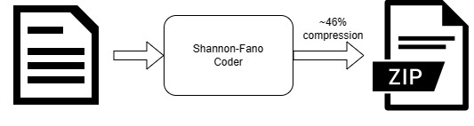
Introduction
Implemented Shannon-Fano coding algorithm in Python for efficient data compression in digital communication systems. Demonstrated proficiency in information theory and coding techniques, enhancing data transmission efficiency for digital communication applications.

Slide 4
Shannon–Fano coding Using Python
Initialization: The program takes a text file as input and reads its content. It then constructs a frequency map of characters in the input text.
Frequency Sorting: The characters are sorted in descending order of their frequencies, and each character is assigned an initial codeword with an empty string.
Partitioning: The code then recursively partitions the characters based on their frequencies, aiming to minimize the codeword length while maintaining unique codewords for each character. This is done by selecting a partition point that balances the frequencies on both sides.

Slide 5
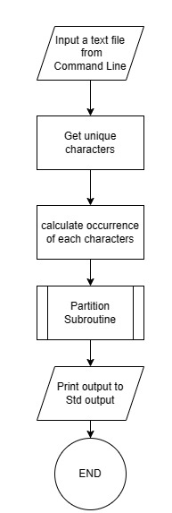
Shannon–Fano coding Using Python
Average Length and Entropy Calculation: After partitioning, the program calculates the average length of the codewords and the entropy of the input text using the shannon-fano coding scheme.
Display and Comparison: The program displays statistics such as symbol frequencies, codewords, average length, entropy, and compression percentage, and it compares the number of bits required for ASCII encoding with the number of bits required using shannon-fano coding, showing the potential compression achieved.

Slide 6
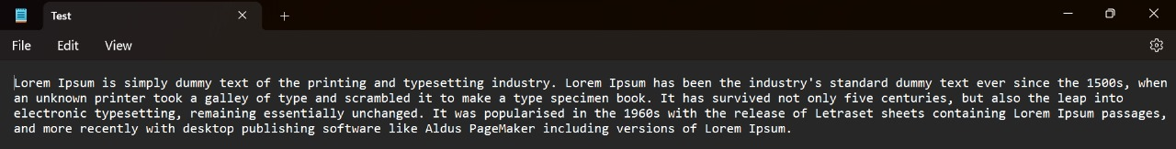
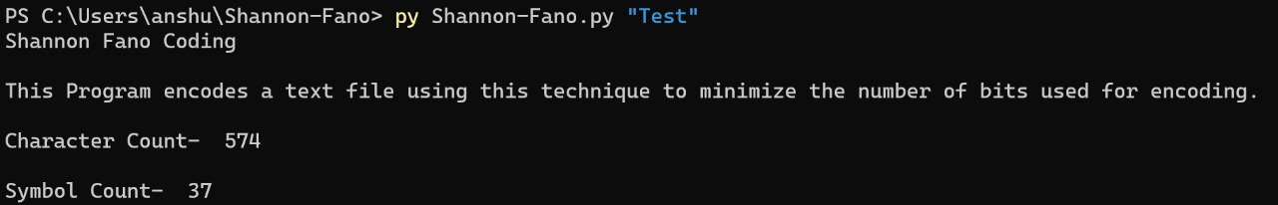
Shannon–Fano coding Using Python
1. Taking Input File:
2. Running the PrograMme:

Slide 7
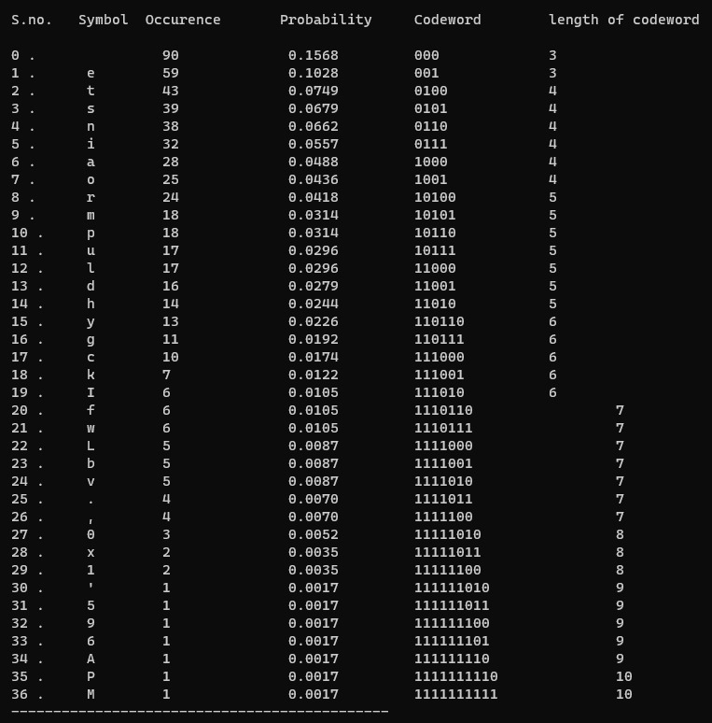
Shannon–Fano coding Using Python
3. Table:

Slide 8
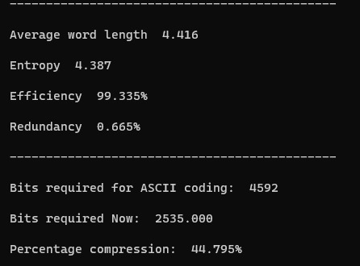
Shannon–Fano coding Using Python
4. Result:

Slide 9
THANK YOU!

